Slide 1
Chapter 1 Input-Output Devices

Slide 2
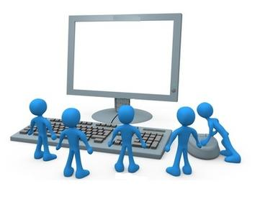
INPUT DEVICE

Slide 3
INPUT DEVICE
Provide means of communication between a computer and outer world
Also known as peripheral devices because they surround the CPU and memory of a computer system
Input devices are used to enter data from the outside world into primary storage
Many types of input device depending on use:
A few are generic
Many are specialized

Slide 4
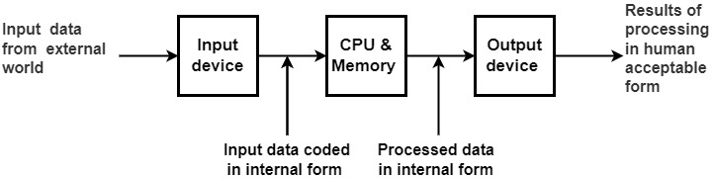
ROLE OF I/O DEVICES

Slide 5
COMMONLY USED INPUT DEVICES
Keyboard devices
Point-and-draw devices
Data scanning devices
Digitizer
Electronic cards based devices
Speech recognition devices
Vision based devices

Slide 6
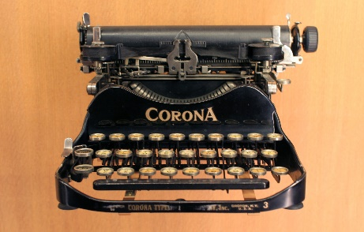
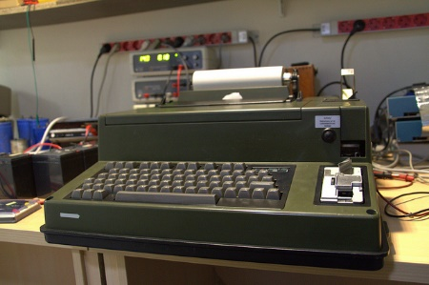
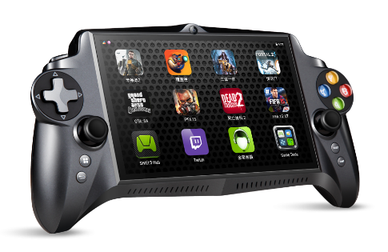
KEYBOARD
Update of original typewriter – invented in late 1800s
Also related to the Telex machine and games console
Good for entering small quantities of textual data
Not good for very large quantities of data – too slow
Not good for non-textual data (graphics or sound)
Usual layout is called QWERTY keyboard (101 keys)
There are many alternative formats and layouts
A ‘key-press’ generates an electronic code to operating system, converted to Unicode characters

Slide 7
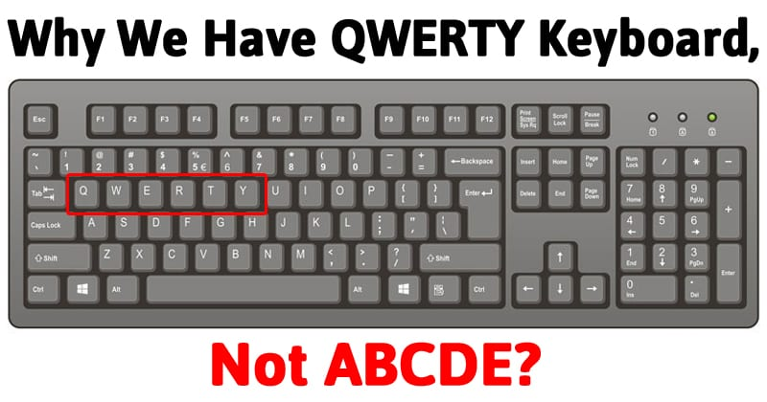
QWERTY KEYBOARD

Slide 8
POINT & DRAW DEVICES
Used to rapidly point to and select a graphic icon or menu item from multiple options displayed on the Graphical User Interface (GUI) of a screen
Used to create graphic elements on the screen such as lines, curves, and freehand shapes
Some commonly used point-and-draw devices are mouse, track ball, joy stick, light pen, and touch screen

Slide 9
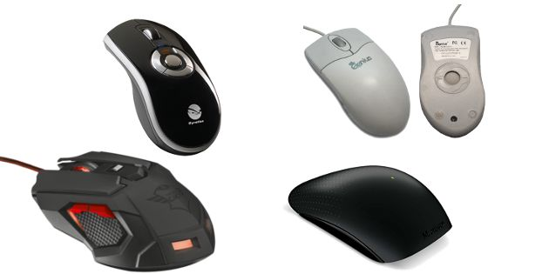
MOUSE
A ‘pointing’ device that captures 2-D spatial movement across a surface
Originally electro-mechanical, now optical
Can be wired or wireless
Multiple styles and features
Invented by Douglas Engelbart in1963
American working at Stanford
Never got any money from his invention
Patent ran out before mice became used

Slide 10
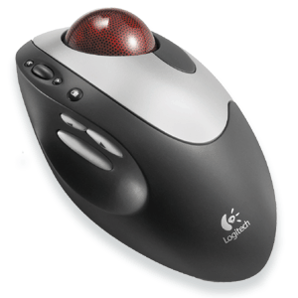
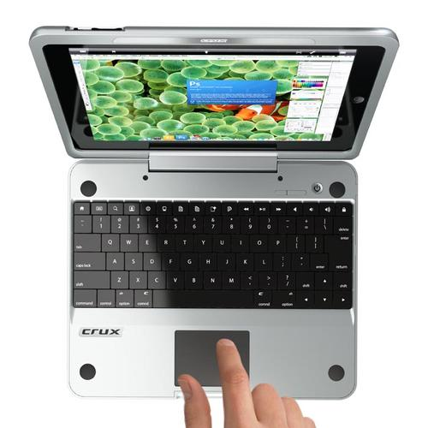
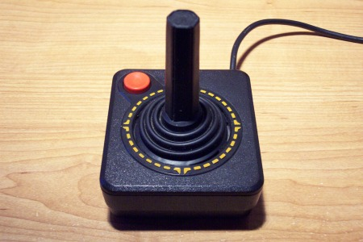
MOUSE
Now many different designs and alternatives:
Tracker ball
Trackpad/touchpad
Joysticks

Slide 11
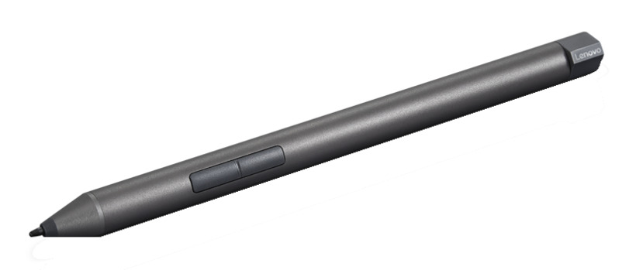
ELECTRONIC PEN
Pen-based point-and-draw device
Used to directly point with it on the screen to select menu items or icons or directly draw graphics on the screen
Can write with it on a special pad for direct input of written information to a system
Pressure on tip of a side button is used to cause same action as right-button-click of a mouse
https://www.youtube.com/watch?v=V_GkPZ5qb7A

Slide 12
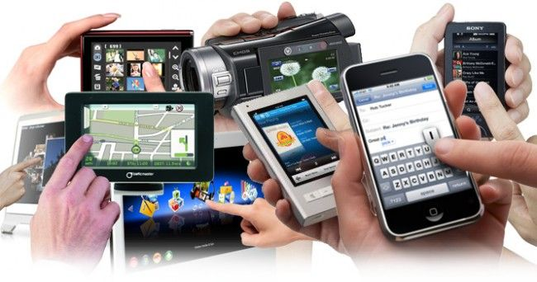
TOUCH SCREEN
Most simple, intuitive, and easiest to learn of all input devices
Enables users to choose from available options by simply touching with their finger the desired icon or menu item displayed on the screen
Most preferred human-computer interface used in information kiosks (unattended interactive information systems such as automatic teller machine or ATM)

Slide 13
QUICK BRAIN – Sample Question 1
What is input device?
Explain the working procedure of I/O device.

Slide 14
DATA SCANNING DEVICES
Input devices that enable direct data entry into a computer system from source documents
Eliminate the need to key in text data into the computer
Due to reduced human effort in data entry, they improve data accuracy and also increase the timeliness of the information processed
Demand high quality of input documents
Some data scanning devices are also capable of recognizing marks or characters
Form design and ink specification usually becomes more critical for accuracy

Slide 15
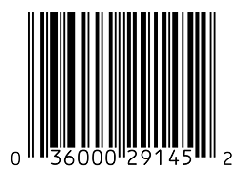

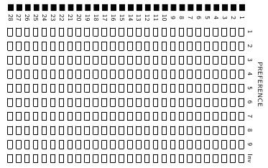
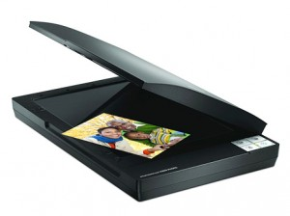
SCANNER
A variation on digital camera technology
Uses reflected light (photons) to translate documents into computer data (electrons)
Scanning technology appears in various forms:
Barcode reader (holding product information)
Q-Code reader (holding various types of encoded data)
Optical mark reader (multiple-choice exams)
Flatbed scanner (document pages and photos)
Barcode
Q-Code
OMR
Flatbed scanner

Slide 16
BAR-CODE READER
Scanner used for reading (decoding) bar-coded data
Bar codes represent alphanumeric data by a combination of adjacent vertical lines (bars) by varying their width and the spacing between them
Scanner uses laser-beam to stroke across pattern of bar code. Different patterns of bars reflect the beam in different ways sensed by a light-sensitive detector
Universal Product Code (UPC) is the most widely known bar coding system
How barcodes work?
https://www.youtube.com/watch?v=e6aR1k-ympo

Slide 17
AN EXAMPLE OF UCP BAR-CODE
Pro duct category character 0 – grocery products
3 – drugs and health related products, etc.
0
21000
67520
Manufacturer/supplier identification number
Specific product code number

Slide 18
OPTICAL MARK READER (OMR)
Scanner capable of recognizing a pre-specified type of mark by pencil or pen
Very useful for grading tests with objective type questions, or for any input data that is of a choice or selection nature
Technique used for recognition of marks involves focusing a light on the page being scanned and detecting the reflected light pattern from the marks
https://www.youtube.com/watch?v=0VPxGt0cw1A

Slide 19
SAMPLE USE OF OMR
For each question, four options are given out of which only one is correct. Choose the correct option and mark your choice against the corresponding question number in the given answer sheet by darkening the corresponding circle with a lead pencil.
The binary equivalent of decimal 4 is: a) 101
b) 111
c) 001
d) 100
The full form of CPU is:
Cursor Positioning Unit
Central Power Unit
Central Processing Unit
None of the above
Which is the largest unit of storage among the following:
Terabyte
Kilobyte
Megabyte
Gigabyte
Indicates direction in which the sheet should be fed to the OMR
1.
 | a | b | c | d
2.
 | a | b | c | d
3.
 | a | b | c | d
(b) Pre-printed answer sheet
(a) Question sheet
A sample use of OMR for grading tests with objective type questions

Slide 20
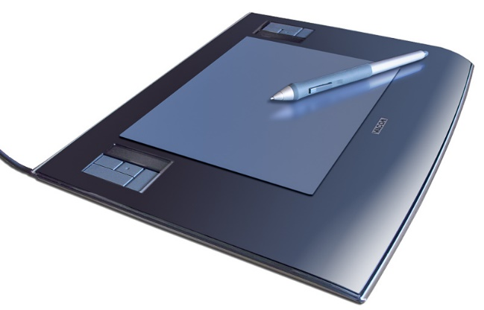
DIGITIZER
Input device used for converting (digitizing) pictures, maps and drawings into digital form for storage in computers
Commonly used in the area of Computer Aided Design (CAD) by architects and engineers to design cars, buildings medical devices, robots, mechanical parts, etc.
Used in the area of Geographical Information System (GIS) for digitizing maps available in paper form
How it works: https://www.youtube.com/watch?v=OuiHvXB1l0w

Slide 21
ELECTRONIC CARD READER
Electronic cards are small plastic cards having encoded data appropriate for the application for which they are used
Electronic-card reader (normally connected to a computer) is used to read data encoded on an electronic card and transfer it to the computer for further processing
Used together as a means of direct data entry into a computer system
Used by banks for use in automatic teller machines (ATMs) and by organizations for controlling access of employees to physically secured areas

Slide 22
SPEECH RECOGNITION DEVICES
Input device that allows a person to input data to a computer system by speaking to it
Today’s speech recognition systems are limited to accepting few words within a relatively small domain and can be used to enter only limited kinds and quantities of data
Types of speech recognition systems
Single word recognition systems can recognize only a single spoken words, such as YES, NO, MOVE, STOP, at a time. Speaker-independent systems are mostly of this type
Continuous speech recognition systems can recognize spoken sentences, such as MOVE TO THE NEXT BLOCK. Such systems are normally speaker- dependent

Slide 23
VISION INPUT SYSTEM
Allow computer to accept input just by seeing an object.
Input data is normally an object’s shape and features in the form of an image
Mainly used today in factories for designing industrial robots that are used for quality-control and assembly processes

Slide 24
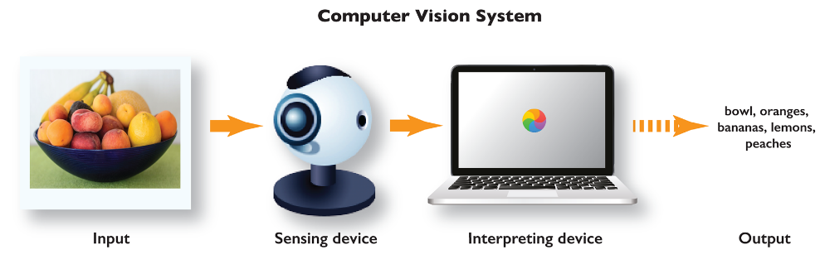
VISION INPUT SYSTEM

Slide 25
QUICK BRAIN – Sample Question 2
Provide 3 examples of input devices with brief description
How does a digitizer work?

